Slide 1

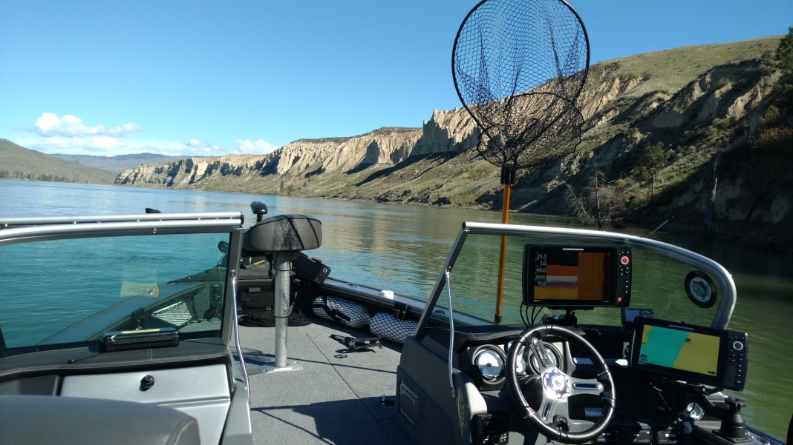
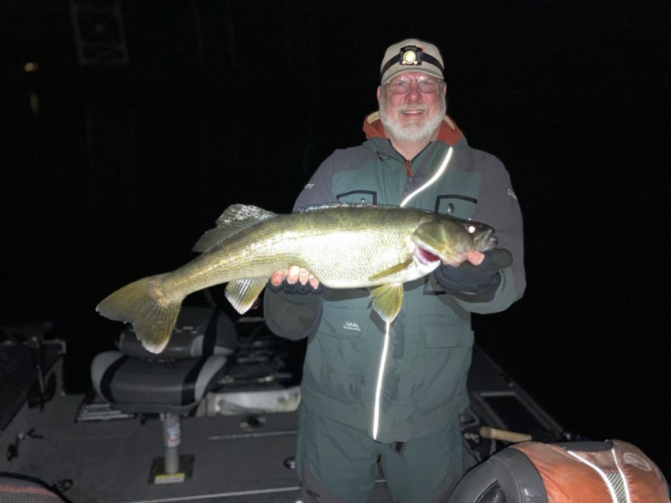
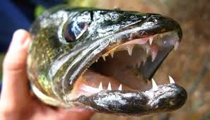
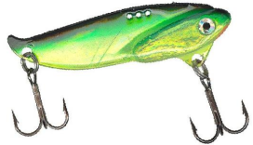
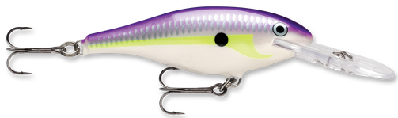
Walker’s
Walleye Tips
These are my opinions, some will disagree

Slide 2
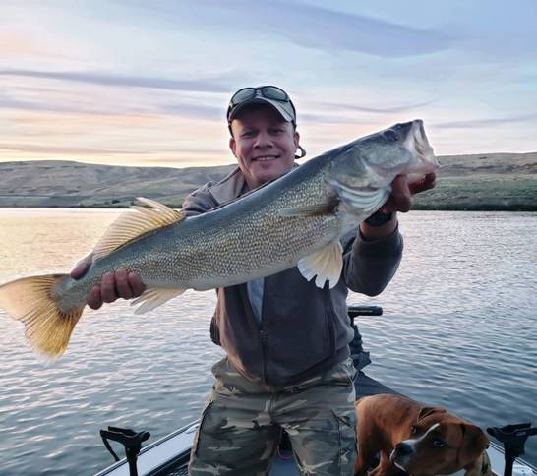
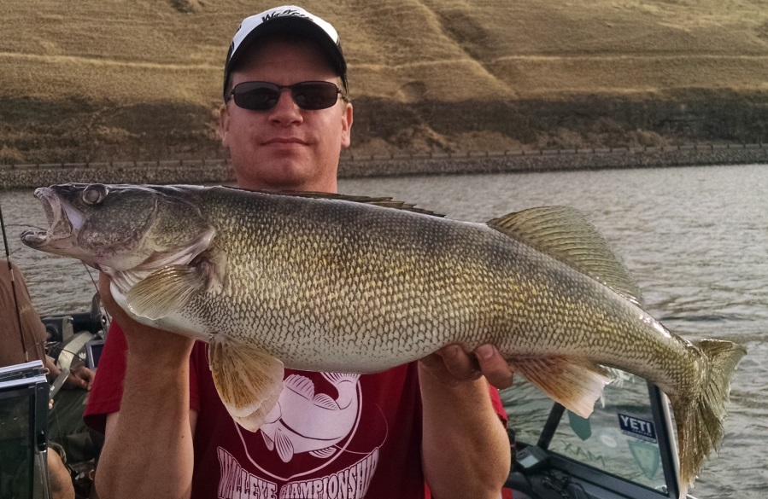
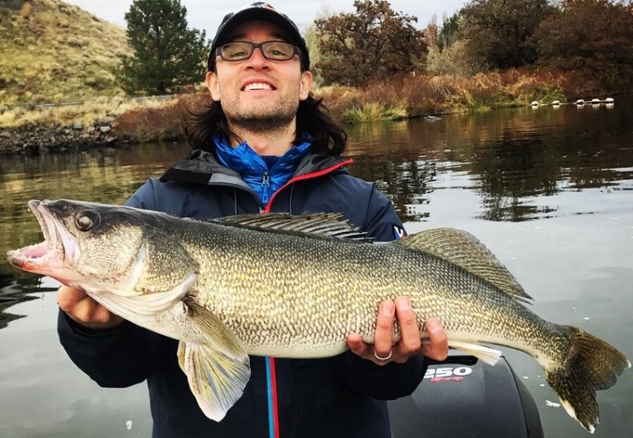

WHY WE DO THIS

Slide 3
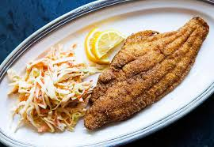
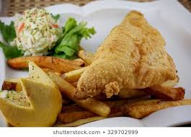
WHY WE DO THIS
16” to 20”
best to eat

Slide 4
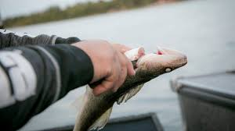
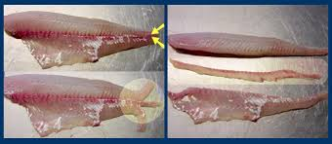
Bleed then Zip

Slide 5
Walleye Cheeks

Slide 6
Walleye Wings

Slide 7
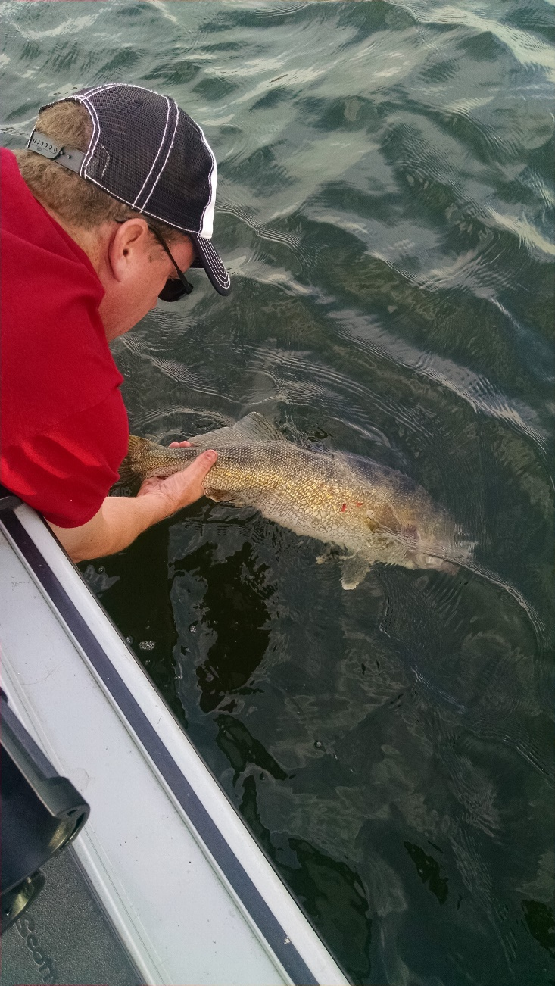
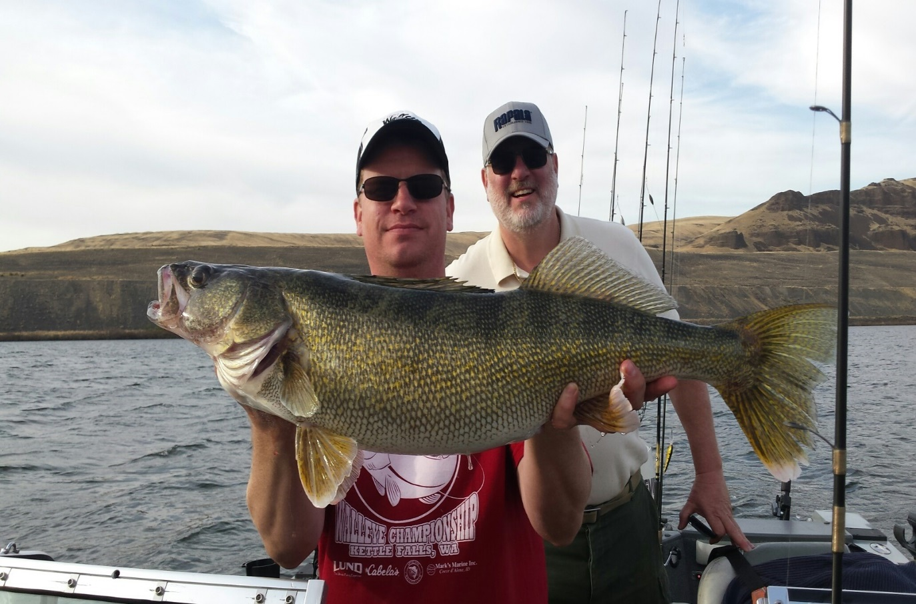
CPR
Catch PHOTO and Release
50,000 to 300,000 eggs per female.
I release all fish over 22 inches

Slide 8
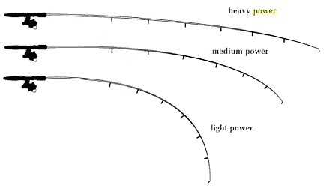
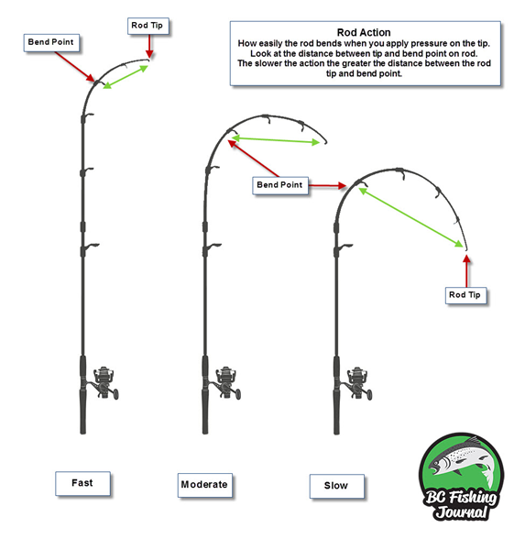

Fishing Rods
POWER
ACTION

Slide 9

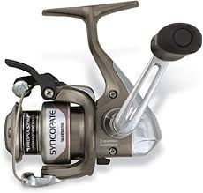
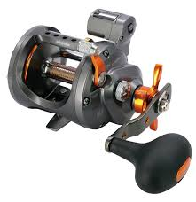
Fishing Reels
Spinning
Line Counter

Slide 10
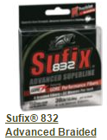
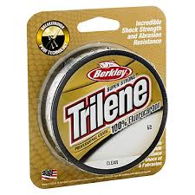
Line Types
Main Line
Leader
20 pound
15 pound

Slide 11
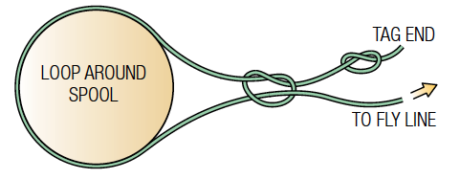
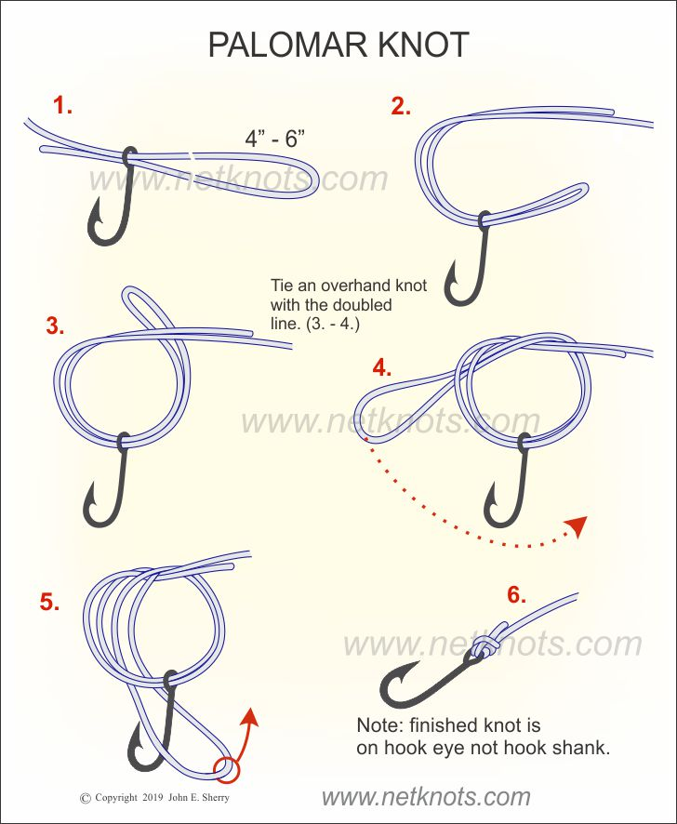
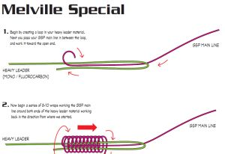
KNOTS

Slide 12

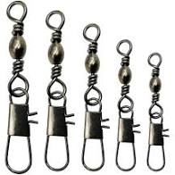
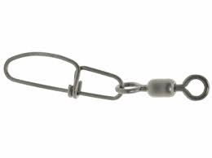
You never know when you when a
10+ pound walleye will come along
BAD SNAP GOOD SNAP

Slide 13

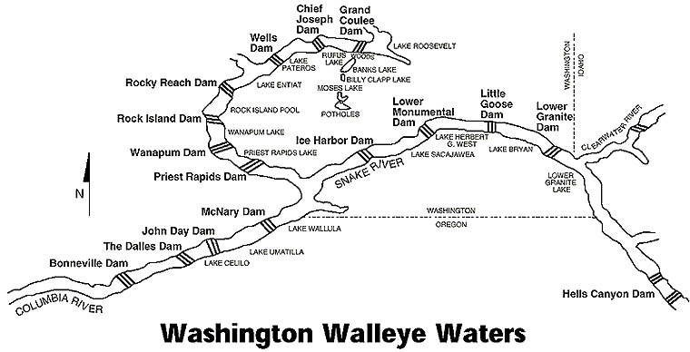
Where to fish for Walleye

Slide 14
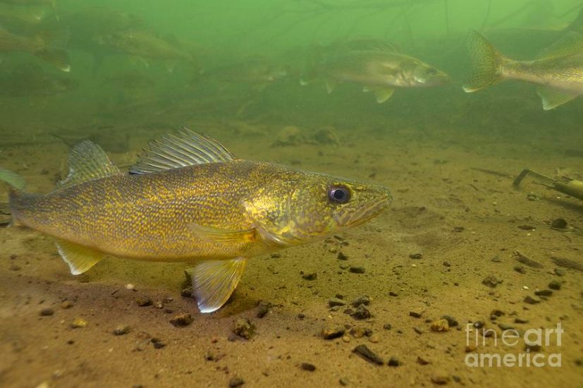
Walleye Behaviors
Tendency to School
Nomadic/Migratory
Opportunistic Feeders
Relate to Depth Contours
Broadcast Spawners

Slide 15
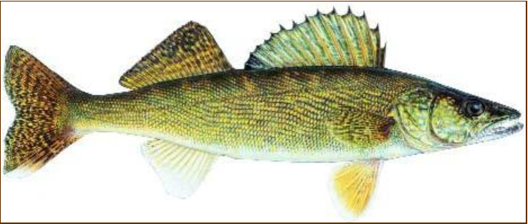
Walleye Senses
See color red, yellow & green
Lateral line
Hearing
Smell
Sound/ Vibration
Sight
Smell
http://kdwpt.state.ks.us/

Slide 16
COLORS in general
Sunny bright Silver Chrome
Cloudy Stained Brass Gold
Muddy Fire Tiger Bright

Slide 17
Seasonal Presentations
Winter BLADES and JIGS
Spring Fisherman’s Choice
Summer CRAWLER SPINNERS
Fall CRANK BAITS

Slide 18
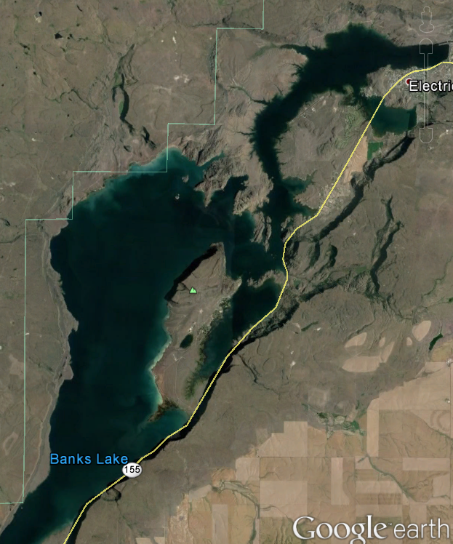
Seasonal
Behaviors
Barker
Flat
Banks Lake Predictable Annual Movements
Winter
Spring
Summer
Fall
Steamboat
Rock

Slide 19
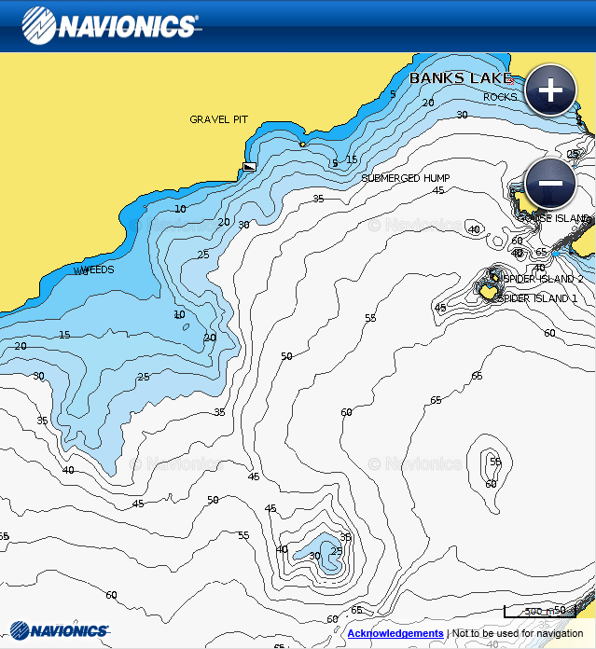

Winter
Structure
Mark’s Marine Inc.
Large Flats Near Deep Water
Under 40 degrees
35 to 60 Feet Depth
Steep Breaks
Active Fish on the Flat
Barker
Flats

Slide 20
Spring
Structure
Mark’s Marine Inc.
May and June
15 to 30 Feet Depth
Spawn 43-45 degrees
Gradual Depth Changes
Wind Blown Shorelines
Weed Beds & Transition Zones
Barker
Flats

Slide 21
Summer
Structure
Mark’s Marine Inc.
July – Mid Sep
50 + degrees
Barker
Flats
Morning/Evening
15 to 25 feet Depth
Main Lake Points
Mid Lake Humps
Bright Hours
25 to 35 feet Depth
Steep Breaks

Slide 22
Fall
Structure
Mark’s Marine Inc.
Barker
Flats
Late Sept - October
Temp drops
35 to 60 Feet Depth
Main Lake Points
Mid Lake Humps

Slide 23
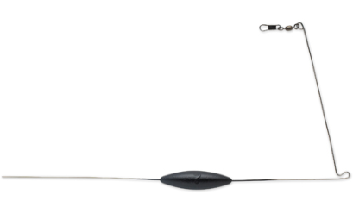
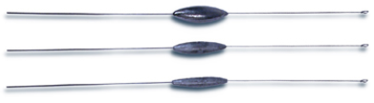
Bottom Bouncers
“L shaped”
“Pencil”

Slide 24
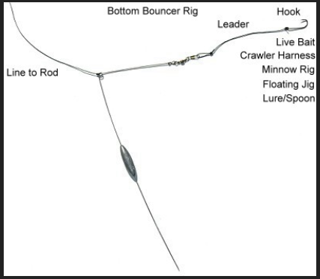
L Shaped Bouncer
www.learninghowtofish.com

Slide 25
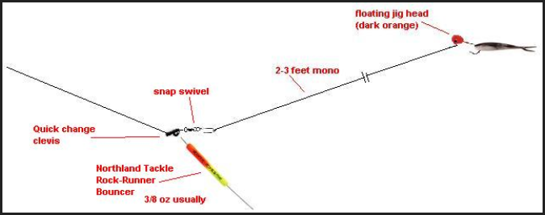
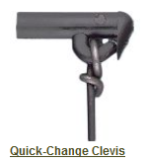
Pencil Bouncer

Slide 26
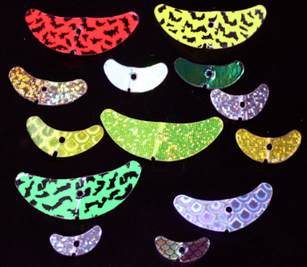
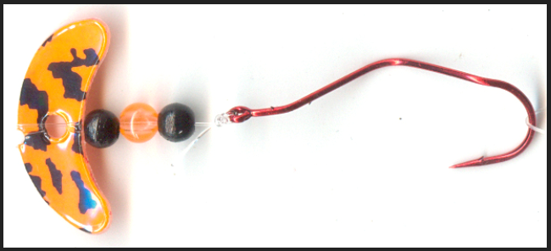
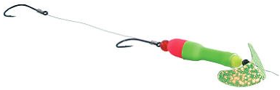
Slow Trolling
Slow Death
0.5 mph to 1 mph
Wally
Pop floats
Smile Blades

Slide 27
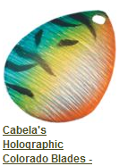
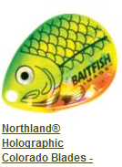
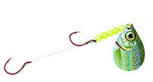
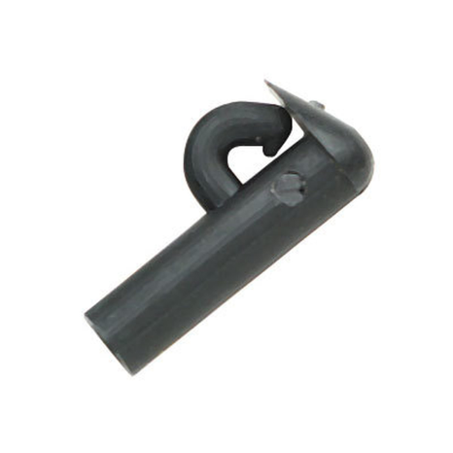

Fast Trolling
Speed 1.2 – 1.5mph
Colorado/Indiana
Blades – Size 2 to 5
Clevis clip on blade

Slide 28
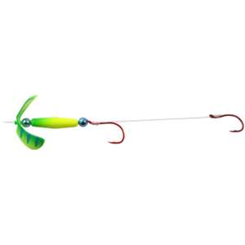
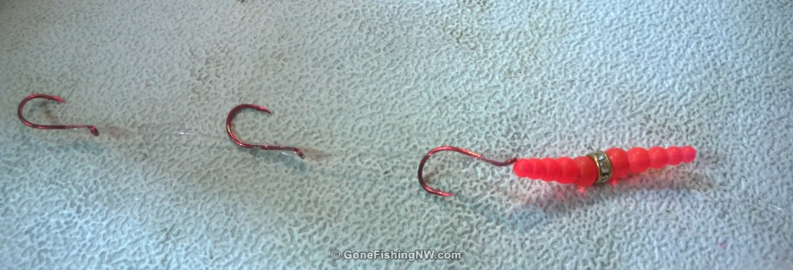
Ever Get Bit Off?
Reason short leader between hooks
LONG LEADER
BETWEEN HOOKS
TRIPLE HOOKS

Slide 29
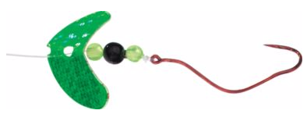
Bouncer Weight
WEIGHT | DEPTH
1 Oz | 10-15 ft
1 ½ Oz | 15-20 ft
2 Oz | 20-25 ft
2 ½ Oz | 25-30 ft
3 Oz | 30+ ft
45 Degrees

Slide 30
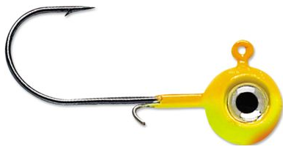
Walleye Jigging
Line to line knot
20 lb
Braid
3 feet
15 lb Mono
1/4 - 1/2 oz

Slide 31
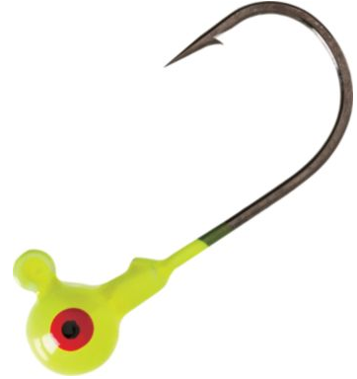
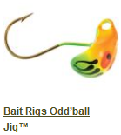
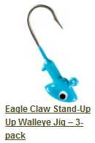
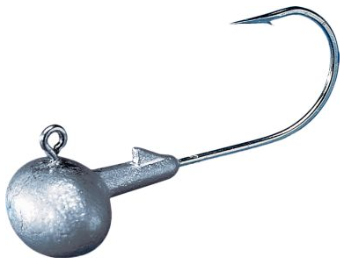
Jig Heads
1/4-3/4 oz
Fast
Aspirin
Round
Slow
Odd Ball
Stand Up
Football

Slide 32




Jig Dressing
2-4”
Grubs*
4-5”
Ringworms*
3-4”
Gulp
Marabou*
* Tipped with crawler

Slide 33



Blade Bait
Braided Line (No Stretch)
60” Mono leader
Line to line knot
or SWIVEL
Med Heavy Power
Fast Action 6’ 6” rod

Slide 34

Blade Bait Presentation
Rip and Drop
Most Effective
15-35 feet

Slide 35



Trolling Crank baits
Cover Water Fast
5 to 40 FOW
Speed Triggers Bites
Big Fish Like Cranks
Profiles Minnow

Slide 36
Trolling Crank baits
Bait | Size | Depth
Flicker Shad | 7cm | 13 feet
Flicker Minnow | 9cm | 18 feet
Flicker Minnow | 11cm | 21 feet
Walleye Runner | 3.5” | 18 feet
Walleye Runner | 4.5” | 25 feet

Slide 37



Trolling Crank baits
Clear Water = Natural Colors
Stained Water = Bright or Fluorescent

Slide 38
Trolling Crank baits
Speed: 1.5 to 2.5 mph
Polomar
Knot
20lb
Braid
6 feet
15lb Mono
Snap Swivel
Snap not a snap swivel
or a Rapala Knot

Slide 39

Trolling Crank baits
Snap weight

Slide 40

Trolling Crank baits
Planner Board

Slide 41

Trolling Crank baits
Drift Sock

Slide 42

Match the Hatch

Slide 43

Match the Hatch

Slide 44

Electronics down and side scan sonar GPS

Slide 45



Spokane Walleye Club
Club Fish
Days
Kettle Falls Picnic
CAST for Kids
www.spokanewalleyeclub.com

Slide 46

Club Calendar
Walleye Waters
Fishing Reports
Pictures
More
www.spokanewalleyeclub.com

Slide 47



